Slide 1
Open Science of Religion and Spirituality? Problems, Myths, and Possibilities
Edward (Ward) B. Davis (Wheaton College)
Sarah A. Schnitker (Baylor University)
We are grateful to Marah Al-Kire (Baylor University) for her assistance with preparation of this presentation.
Notes:
Ward: slides 1-6
Sarah: slides 7-14
Ward: slides 15-end

Slide 2
How did we end up here?
Culture
Publish or perish
Quantity over quality
Flashy findings
Questionable research practices
p-hacking (exploring alternatives until something is significant)
HARKing (“hypothesizing” after the results are known)
Selective reporting of variables and results
Suppressing nonsignificant findings (file drawer problem)
Lack of rigor & reproducibility
Notes:
Before jumping into the idea of open science in psych, its important to provide some context. How did we end up here? Well, there are varying opinions on this, but there were several persistent issues, and at least one catalyst. Persistent issues included this larger cultural value in academia referred to as publish or perish, which is exactly what it sounds like. Academics need to publish, or they don't get tenure/could lose their positions. This of course led to some haphazard practices which are referred to as QRPs. These included things such as HARKing your data (hypothesizing after results are known), cherry picking results, and even falsifying data/p-hacking (at the extreme level). In a culture of high-stakes productivity, another common trade-off is methodological rigor. For example, experimental research especially takes a lot of time, and high quality work often includes multiple well-designed studies. Rigor can be sacrificed for immediate payoff.
Now the catalyst(s). There is really one infamous one listed here, but all three are high profile examples of failed replications. Unfortunately for these authors (especially Dr. Amy Cuddy), these cases were at the forefront of doubt cast upon psychological research.
Enter: 2015 science article and OS reform movement

Slide 3
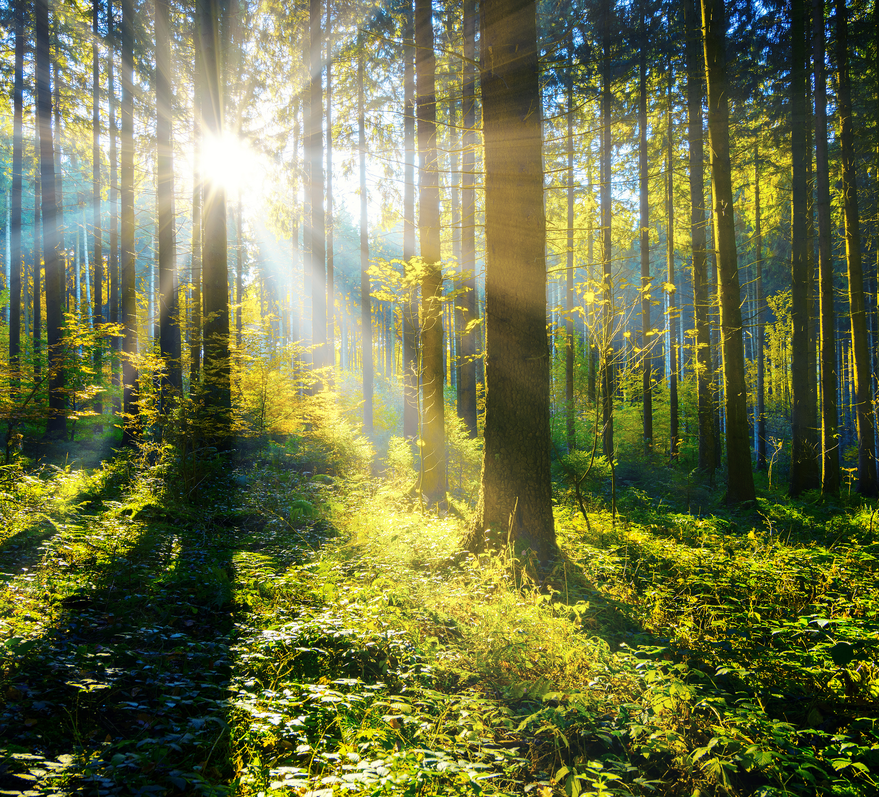
Open Science Movement
Movement to increase
Openness
Transparency
Integrity
Reproducibility
Improving
Access to research
Ability to replicate

Slide 4
Open Science Practices
Preregistration
Prespecifying study plans and predictions
Open sharing
Materials
Data
Publications/preprints
Registered report format
Peer reviewing studies before they are conducted
Publishing the results regardless of the findings

Slide 5
Open science practices are becoming increasingly common and expected.

Slide 6
But they are not yet well-understood or well-utilized in the psychology of religion/spirituality field.

Slide 7
Common Myths About Open Science
Concern
Response
Open science practices do not allow for exploratory research.
Open science practices are onerous and make it harder to get research done.
Open science practices focus too much on method to the detriment of theory.
They allow for it, but they require researchers to have integrity in writing up findings as exploratory.
You can preregister exploratory work.
They front load the effort but do not change overall amount of time if researchers are conducting quality research (and can save wasted efforts!).
That might be a short-term effect, but in the long-term, they should make theory more important, as we have to hypothesize a priori with transparency.

Slide 8
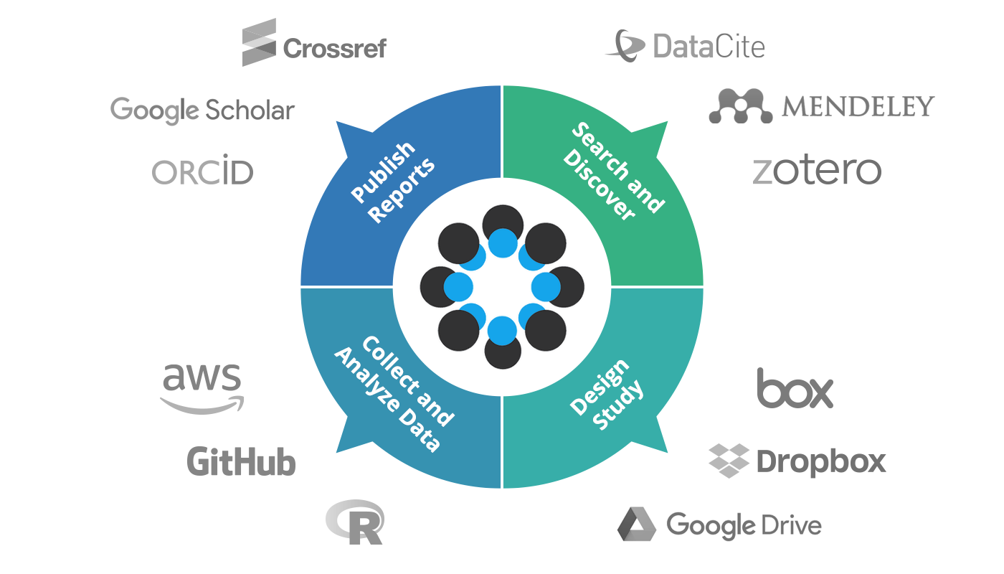
Open Science Framework (OSF)
Open-source repository
Centralized workflow
Organization
Transparency
Notes:
The open science framework from the center for open science is really the posterchild of the open science movement in psychology. There might be other places to host all of the materials I'm about to discuss, but this is the one most used.
OSF is a publically available (free) website which hosts materials for research (I.e., repository). It's similar to other organizing tools you're probably familiar with such as Google Drive or DropBox, but this is specifically for research and publically available.
The idea is to help organize and share research in one space.

Slide 9
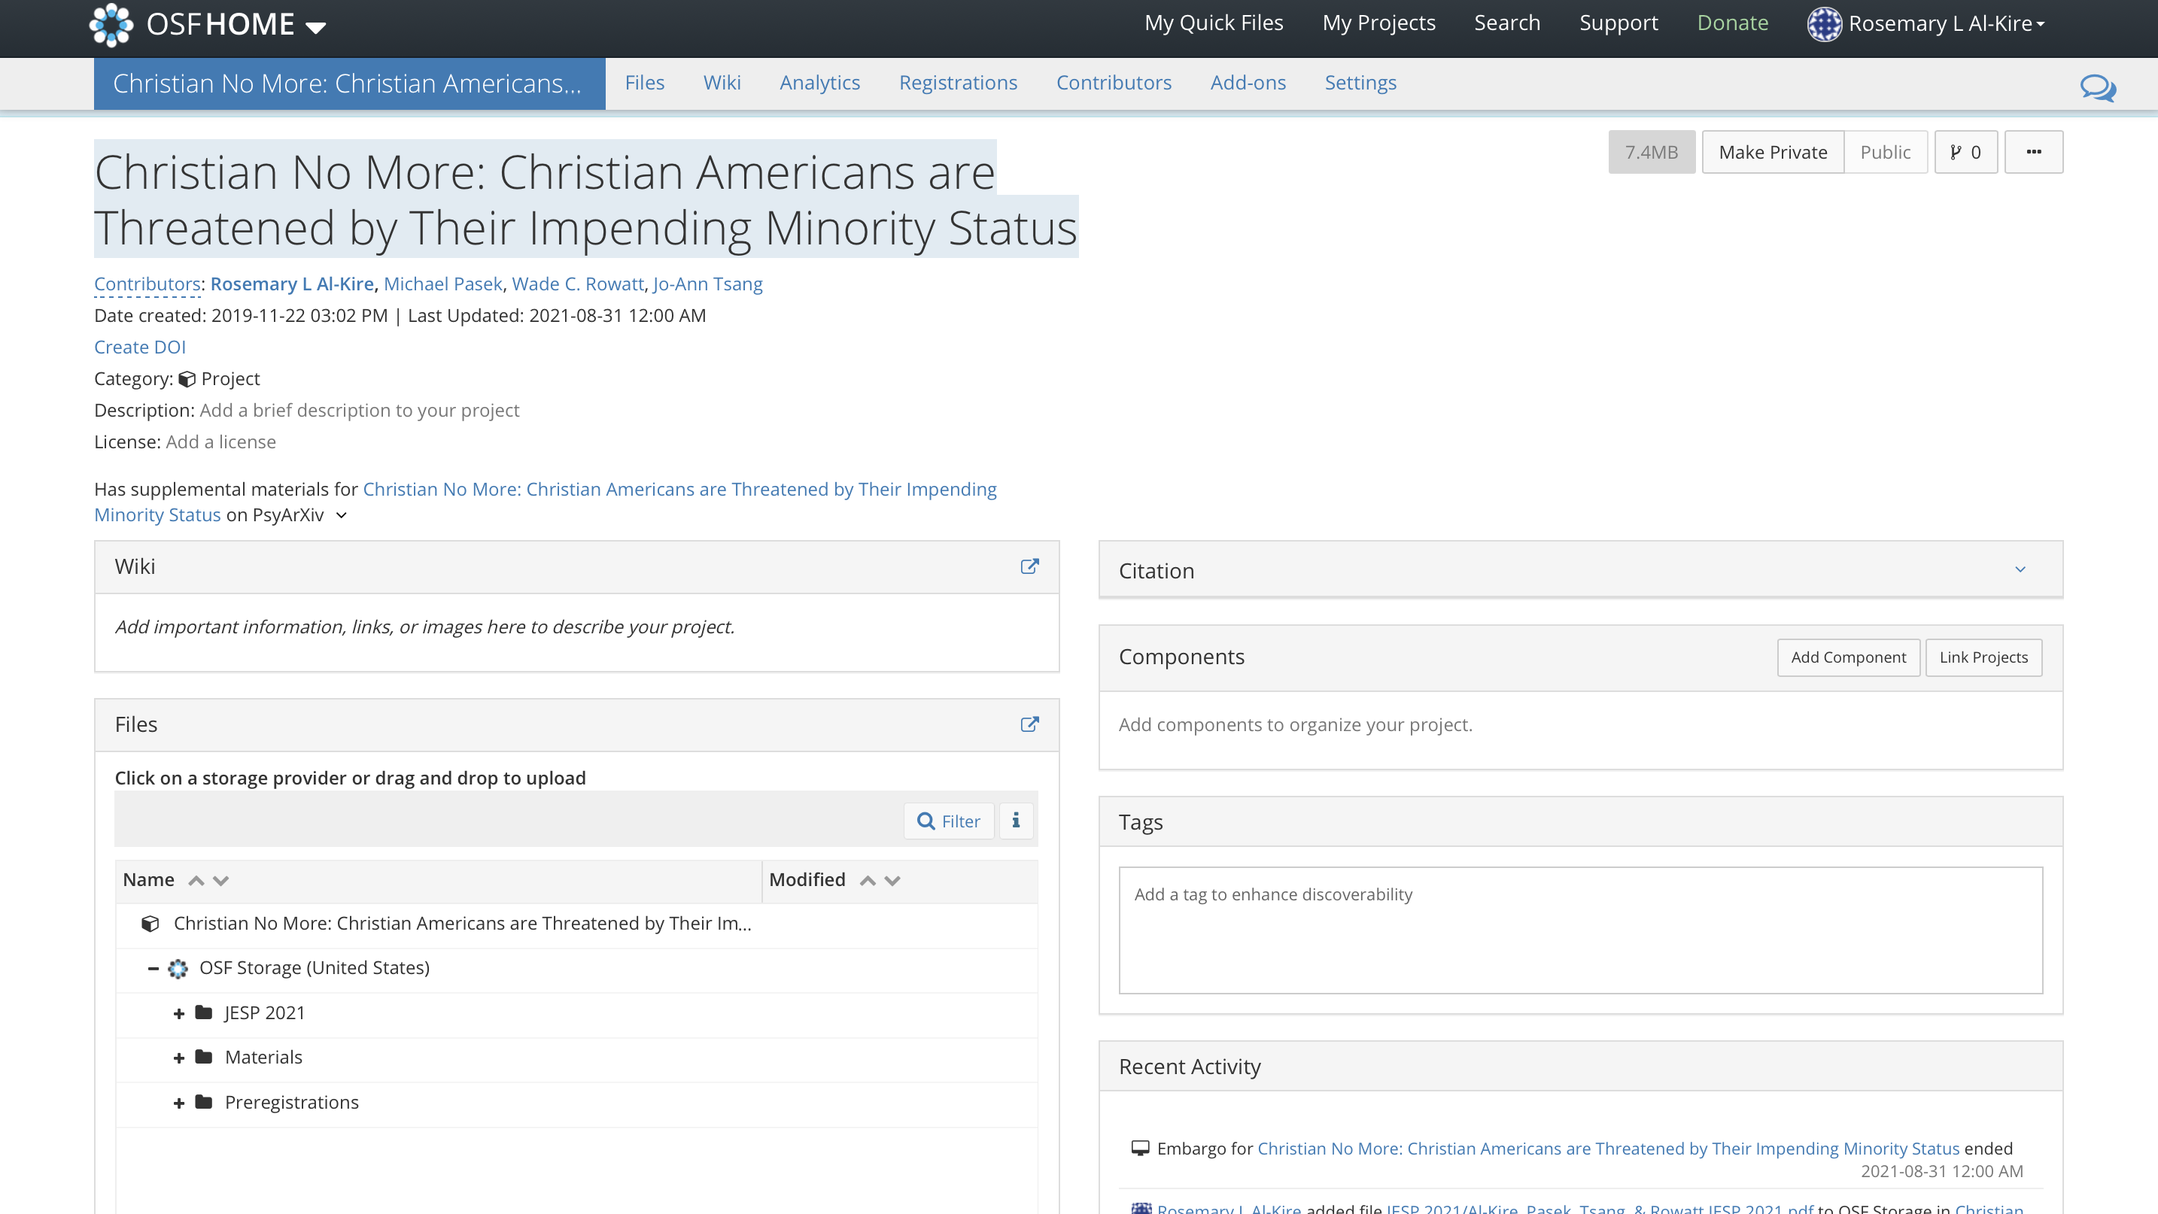
OSF Project Example
Registrations
Collaborators
Files
Components
Recent activity (all changes are public)
Link to other projects
Notes:
Here is an example of a study project I have on OSF. There are a few things to point out here: first you can see all of the collaborators listed, then the files section houses all of the things I want to host on OSF, I could generate a citation if I wanted and add tags so people can search by keyword to find this and related projects. Finally, the bottom right box "recent activity" denotes all changes made (and by whom) to anything on this study. You can see this is already public, but I kept this private until our article was accepted for publication.

Slide 10
Hypotheses
Exploratory & Confirmatory
Method
Planned Analyses
Measures; Sample size
Exclusions; Transformations
Notes:
Preregistration involves specifying aspects of your research questions, design, and approach before data are collected or analyzed.
This is a bit of work on the front end, but pays off later as you will have an outline of steps to analyze and report your results.
For example, my preregistrations lay out exactly how I need to specify a filter variable for who to exclude from my analyses, and which tests I planned to run to analyze a hypothesis. You can even write your analysis syntax ahead of time based on this.

Slide 11
Preregistration Templates
OSF has various templates, examples, and guides on their website
Primary data
Secondary data
Qualitative
Notes:
Getting started can be hard, but templates and examples are provided on OSF.
Step by Step Guide: https://help.osf.io/hc/en-us/articles/360019738834-Create-a-Preregistration
*Important to note that preregistration is not a prison! Plans change, the idea is just to be fully transparent about your process.
*Also important to note that you can write a bad preregistration. PR does not necessarily mean its good!

Slide 12
How do you know if open science practices are implemented? Badges
Notes:
There are other aspects of open science which integrate with OSF. These primarily include open data and materials, which you can upload to a research project/folder on OSF. This is basically like a professional google drive specific to your study that can be linked to a paper. This project folder should have the names of all collaborators, and host files such as the preregistration, study materials (survey), and data.
Also keep an eye out for OSF links in manuscripts. These are often in the method section.
You can make these folders private until you're ready to share them, so no need to worry about your data or ideas being poached.
Partially an incentive, but also a way to communicate if open science practices are being followed, over 75 journals offer open science badges.

Slide 13
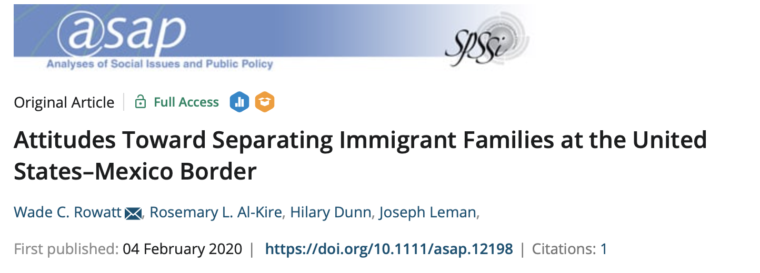
Example of Badges
Notes:
This article has two badges: open data (blue) and open materials (orange)

Slide 14
PsyArXiv Preprints
Notes:
Another cool feature on OSF is the ability to upload preprints of manuscripts. These can be write ups at any stage of the writing process, though usually authors upload their peer-reviewed manuscripts. Almost always, authors will specify whether their work has been peer-reviewed yet on the title page.
This is a great way to share your research without the paywall of journals. Make sure you upload a PDF, but not the journal proofs or the formatted manuscript (that belongs to the publisher).

Slide 15
Registered Reports
Offered at some journals
Emphasizes research question and methodology
Peer review before you collect data
Provisional acceptance of manuscript (results-blind)
Notes:
The last open science feature I want to mention is the registered report. Not every journal offers this, but it is becoming more common. In this format, you essentially submit a research proposal for peer review. This is a great way to get feedback ahead of time from experts in the field. If provisionally accepted, this essentially guaruntees publication of your manuscript, regardless of whether or not your hypotheses are supported, so long as you adhere to the plan.
"Registered Reports is a publishing format that emphasizes the importance of the research question and the quality of methodology by conducting peer review prior to data collection. High quality protocols are then provisionally accepted for publication if the authors follow through with the registered methodology.
This format is designed to reward best practices in adhering to the hypothetico-deductive model of the scientific method. It eliminates a variety of questionable research practices, including low statistical power, selective reporting of results, and publication bias, while allowing complete flexibility to report serendipitous findings."- OSF

Slide 16
Registered Report Example
Notes:
Here is an example of a registered report. Many of these are large-scale (multi-site) collaborations to test old questions with better methods (and much larger sample sizes).

Slide 17
Open Science in Your Research
Knowledge
Application
Social Norms
Notes:
Open science practices are constantly evolving. Stay in the loop!
Jump in and just get started. Create OSF pages for your studies you're working on and upload your materials and data. Then tackle a preregistration.
Get your friends on board and learn together.

Slide 18
https://www.openscienceofreligion.com/

Slide 19
Questions?

